Slide 1

Airline Reservation System
Analysis By Using MySQL

Slide 2

Introduction
Airline Reservation System : is a database-driven application designed to manage and streamline various aspects of airline operations, including flight schedules, passenger bookings, seat reservations, ticketing, and payments.
Key Features of the SQL-based System
Centralized Database:
Stores all data in an organized, structured format.
Ensures consistency and accuracy.
Efficient Querying:
SQL queries allow real-time data retrieval for tasks such as checking seat availability or processing reservations.
Data Relationships:
SQL enables seamless linking of data through foreign key relationships (e.g., a passenger linked to their reservations).
This Photo by Unknown Author is licensed under CC BY

Slide 3
Database Design Overview
Entities and Relationships : Discuss the main entities such as Passengers, Flights, Reservations, Payments,Ticket.
Entity Descriptions
Passengers: Stores details like passenger_id, name,contact, etc
Flights: Includes flight_id, origin, destination, departure_time, arrival_time, etc.
Reservations: Links passengers to flights with reservation_id, status, etc
Payments: Stores payment-related data like payment_id, amount, status, reservation_id.
Tickets: Stores seat related data like Seat_no,Flight_id etc.

Slide 4
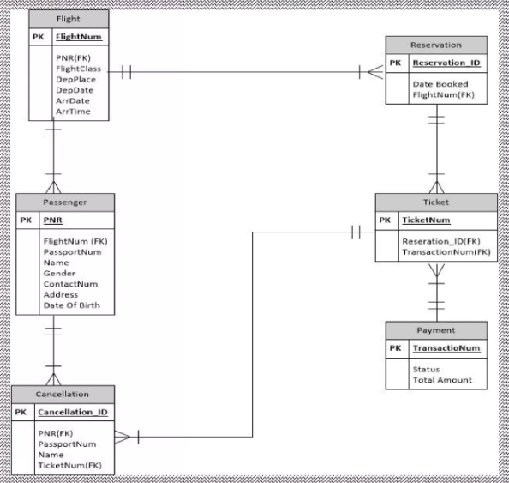
.
Explain Relationships-
One-to-Many: Each Flight can have many Reservations
Many-to-Many: Passengers and Flights through the Reservations table.
Foreign Keys: Flight_id in Reservations links to Flights
.

Slide 5
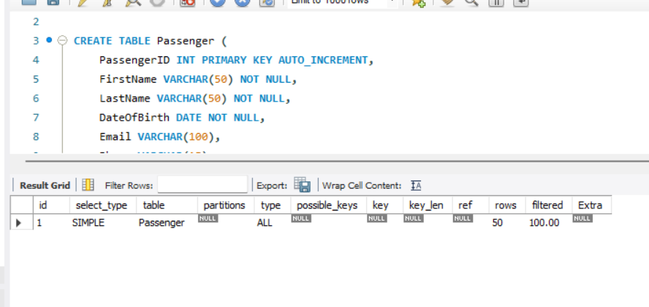
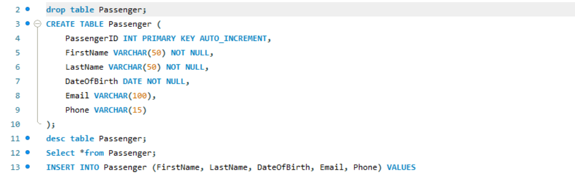
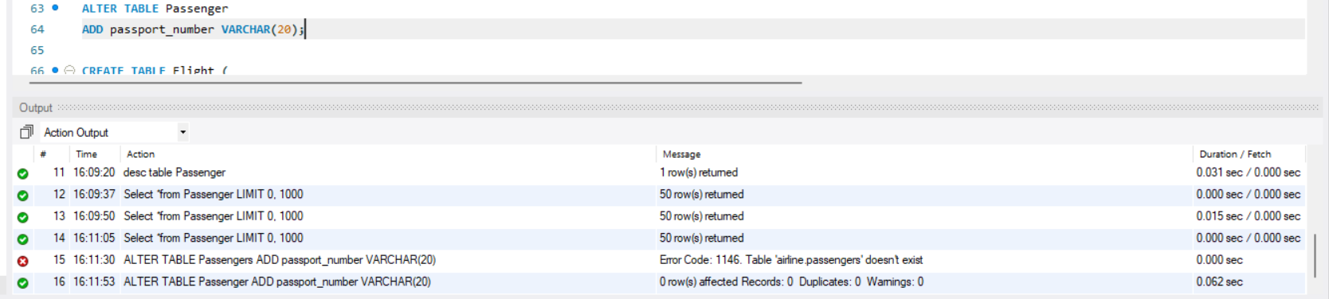
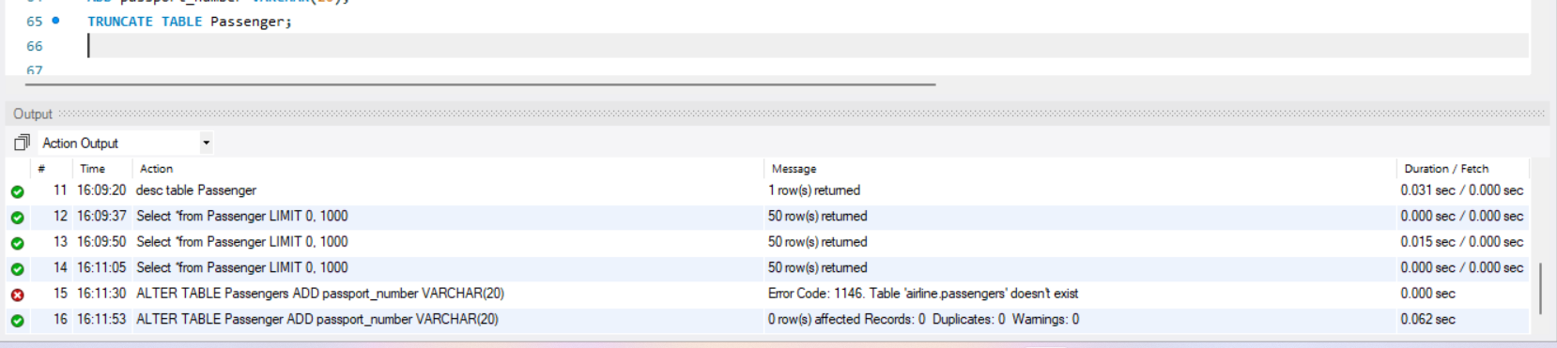
DDL– Data definition language 1)Create 2)Drop 3)Alter 4)Truncate

Slide 6

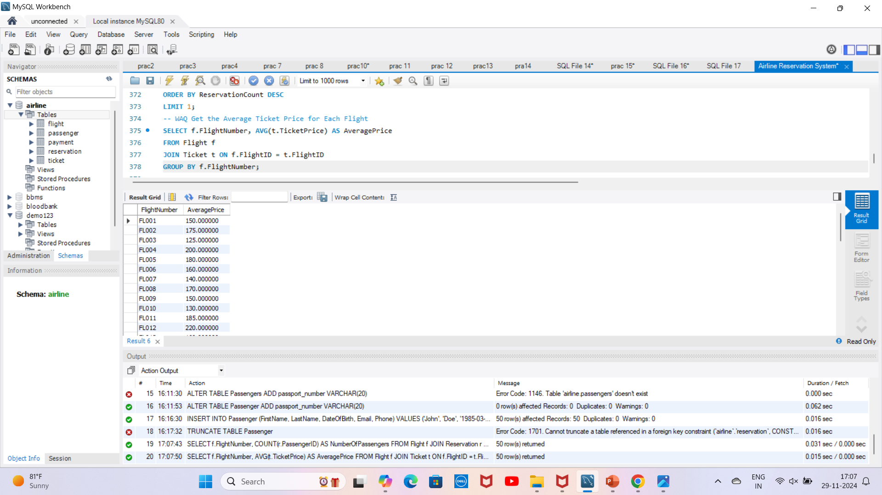
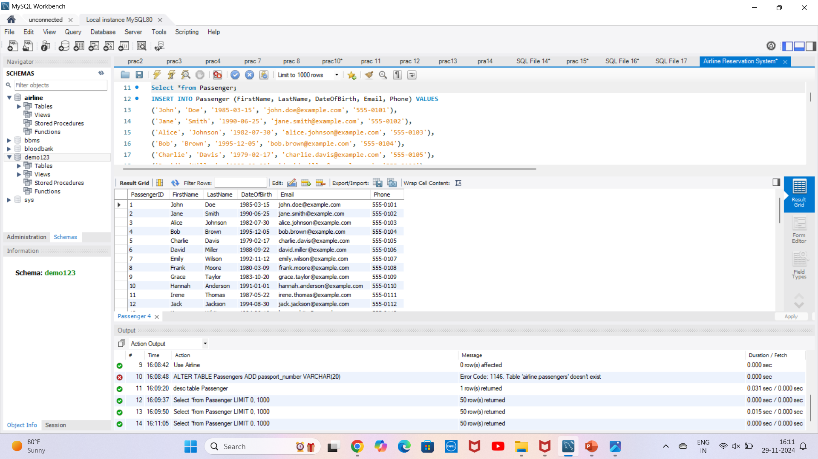
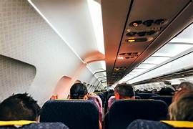
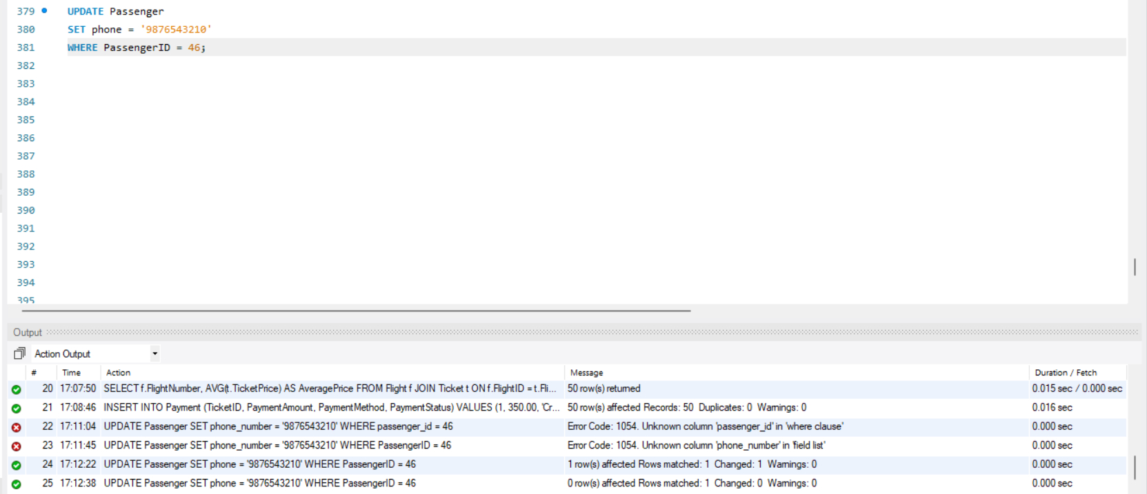
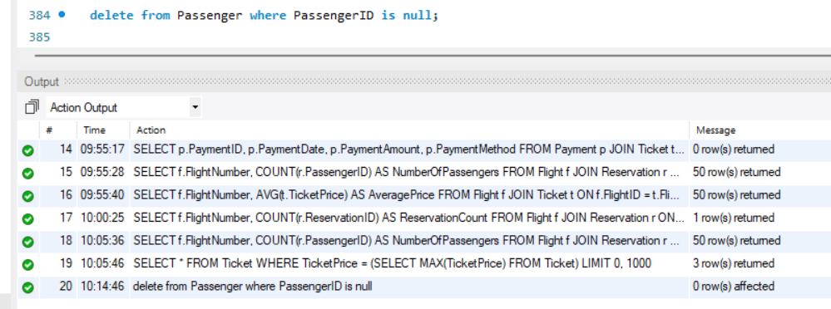

DML-Data Manipulation Language
1} Select: 2} Insert:
3} Update: 4}Delete

Slide 7
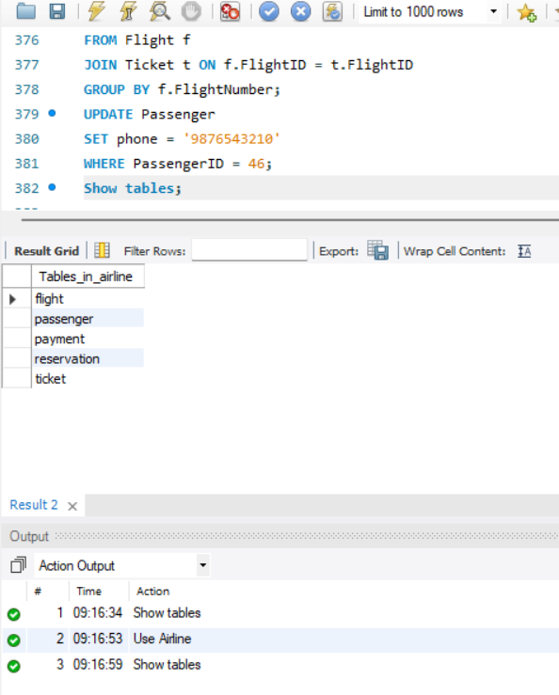
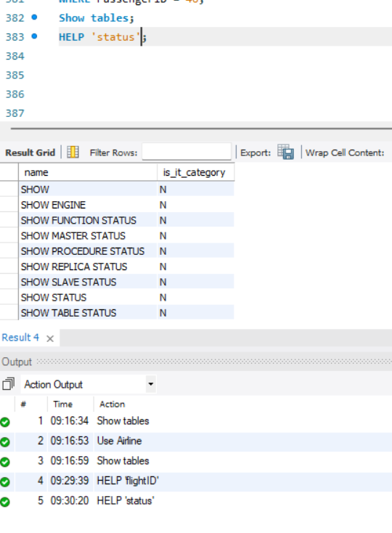
DQL-Data Query Language
1)Show 2)Help

Slide 8

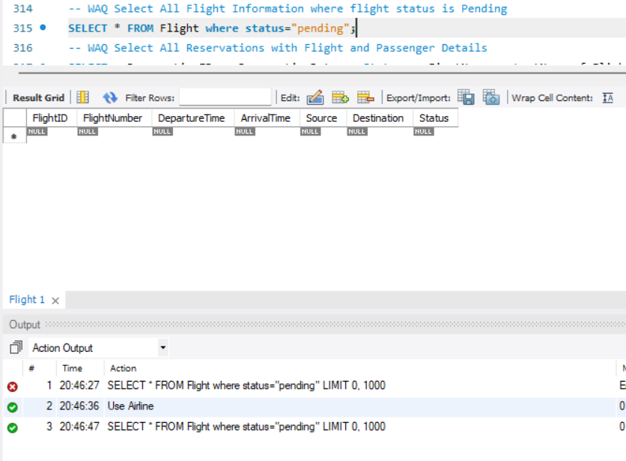
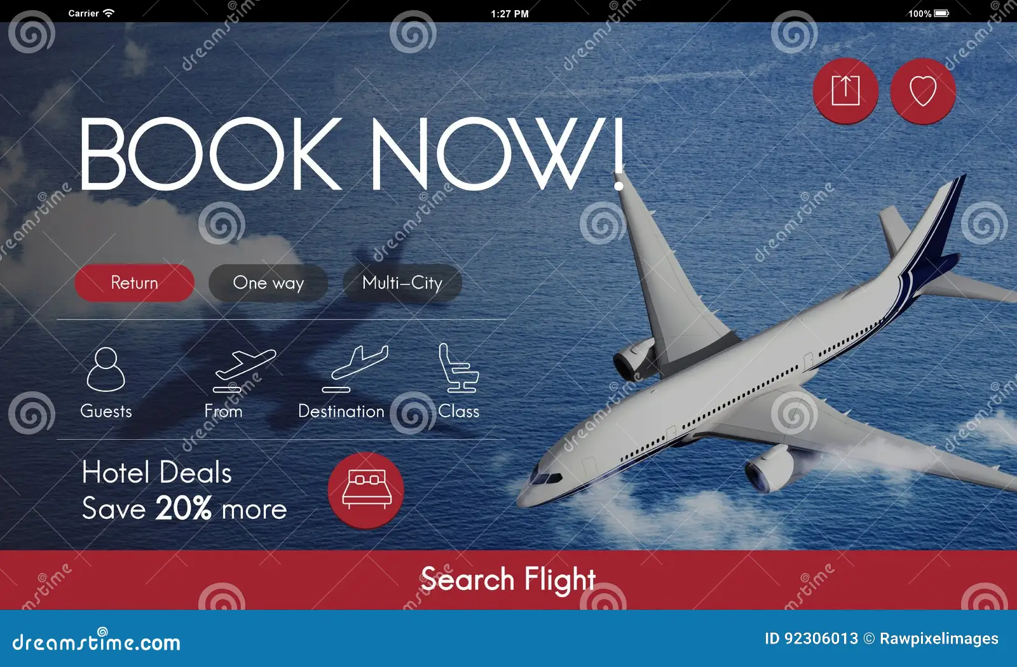
Find all flight information where flight status is pending?
SELECT * FROM Flight where status="pending";

Slide 9

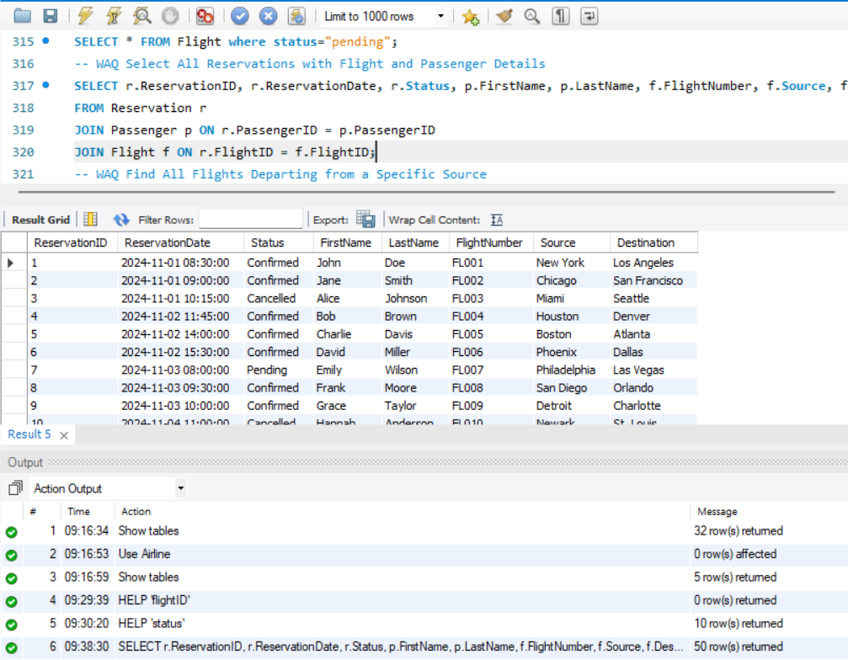

Select All Reservations with Flight and Passenger Details?
SELECT r.ReservationID, r.ReservationDate, r.Status, p.FirstName, p.LastName, f.FlightNumber, f.Source, f.Destination
FROM Reservation r
JOIN Passenger p ON r.PassengerID = p.PassengerID
JOIN Flight f ON r.FlightID = f.FlightID;

Slide 10
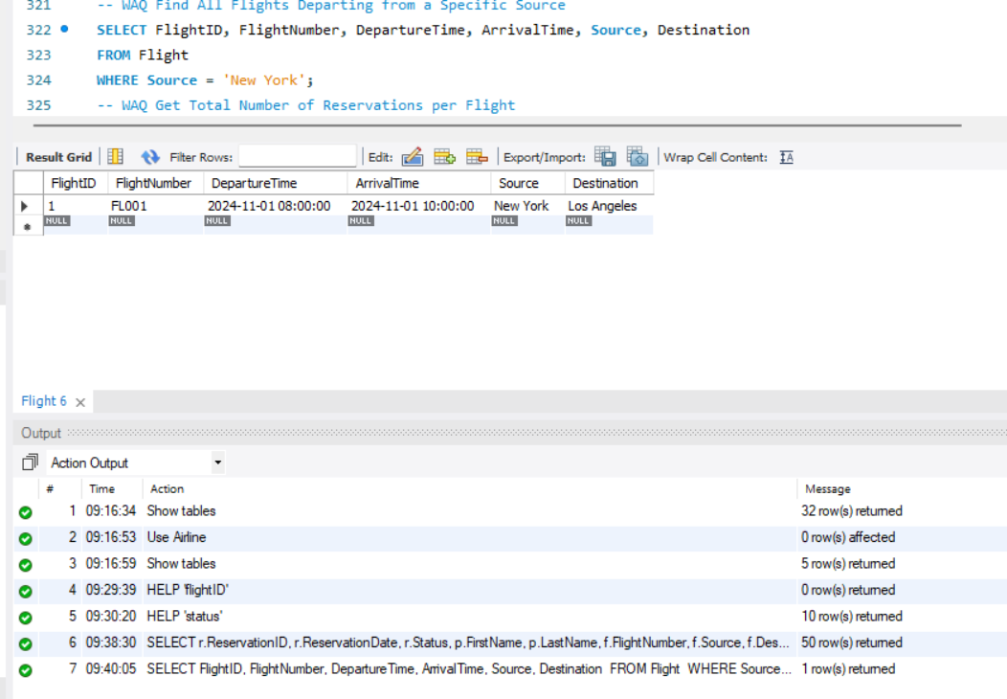


Find All Flights Departing from a Specific Source?
SELECT FlightID, FlightNumber, DepartureTime, ArrivalTime, Source, Destination FROM Flight WHERE Source = 'New York';

Slide 11
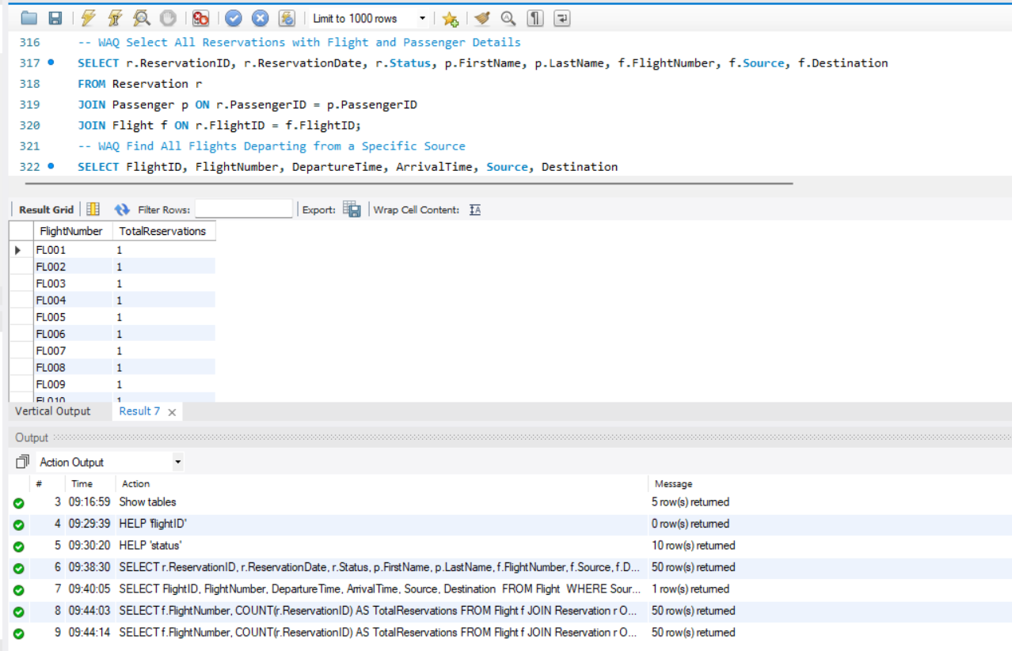

Get Total Number of Reservations per Flight?
SELECT f.FlightNumber, COUNT(r.ReservationID) AS TotalReservations FROM Flight f JOIN Reservation r
ON f.FlightID = r.FlightID GROUP BY f.FlightNumber;

Slide 12
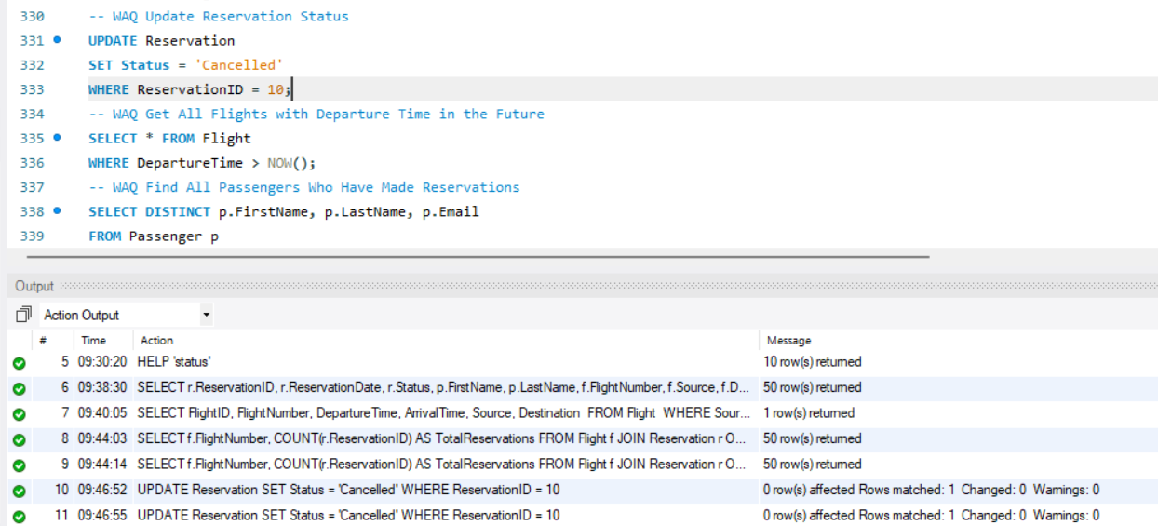

Update Reservation Status?
UPDATE ReservationSET Status = 'Cancelled’ WHERE ReservationID = 10;

Slide 13

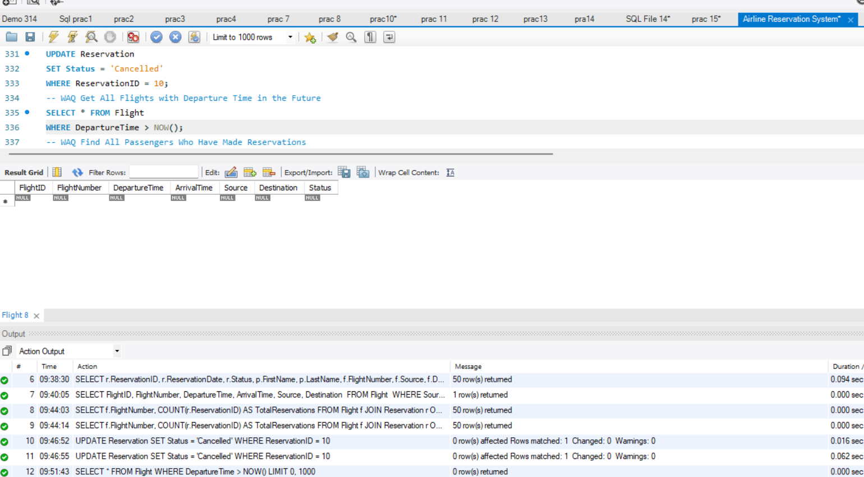

Get All Flights with Departure Time in the Future
SELECT * FROM Flight WHERE DepartureTime > NOW():

Slide 14

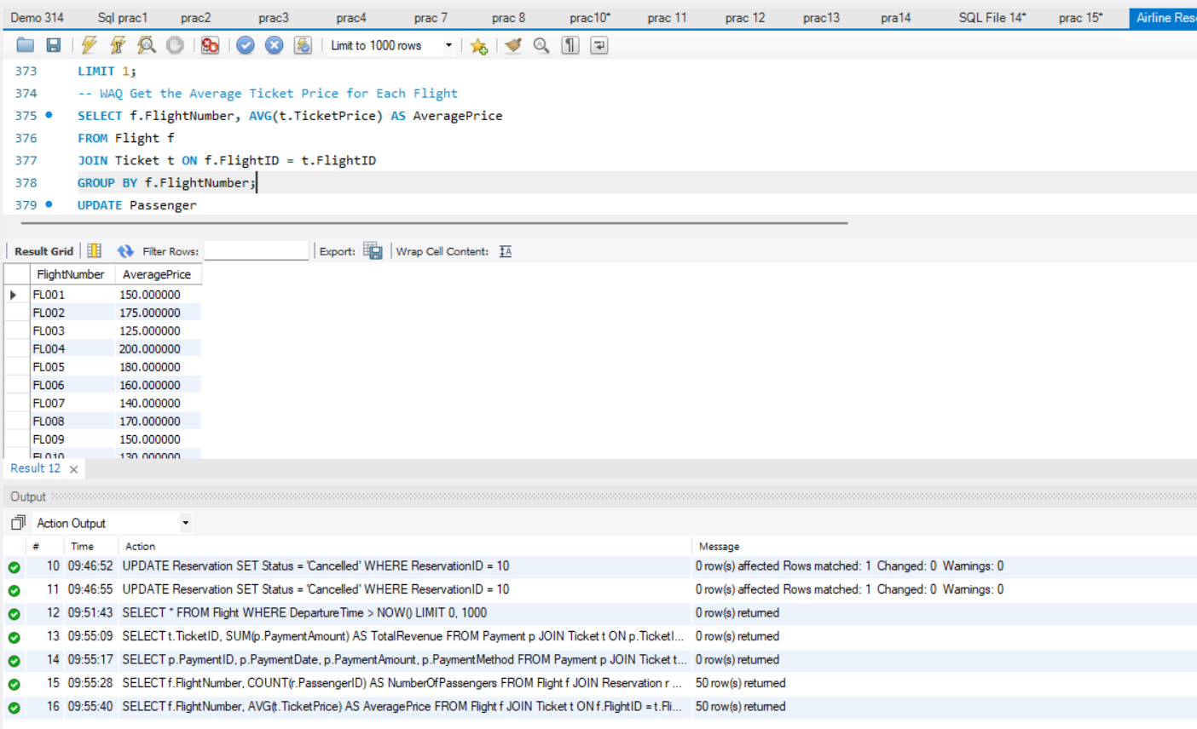
Get the Average Ticket Price for Each Flight
SELECT f.FlightNumber, AVG(t.TicketPrice) AS AveragePrice FROM Flight fJOIN Ticket t ON f.FlightID = t.FlightID GROUP BY f.FlightNumber;

Slide 15
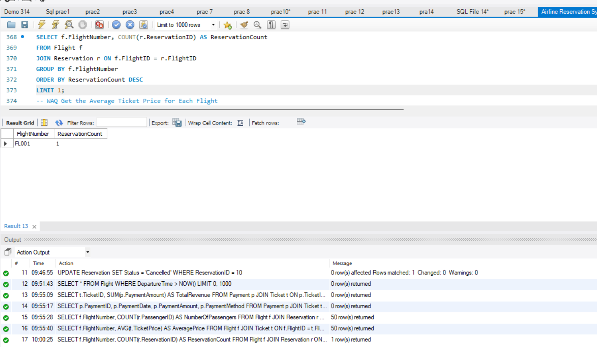

Find the Most Popular Flight (Most Reservations)
SELECT f.FlightNumber, COUNT(r.ReservationID) AS ReservationCount FROM Flight f JOIN Reservation r ON f.FlightID = r.FlightID GROUP BY f.FlightNumber ORDER BY ReservationCount DESC LIMIT 1;

Slide 16
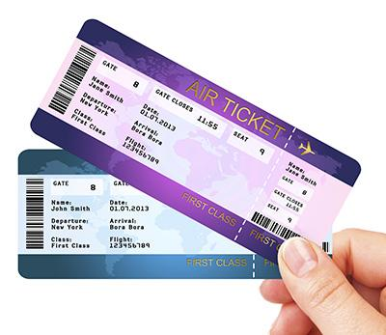
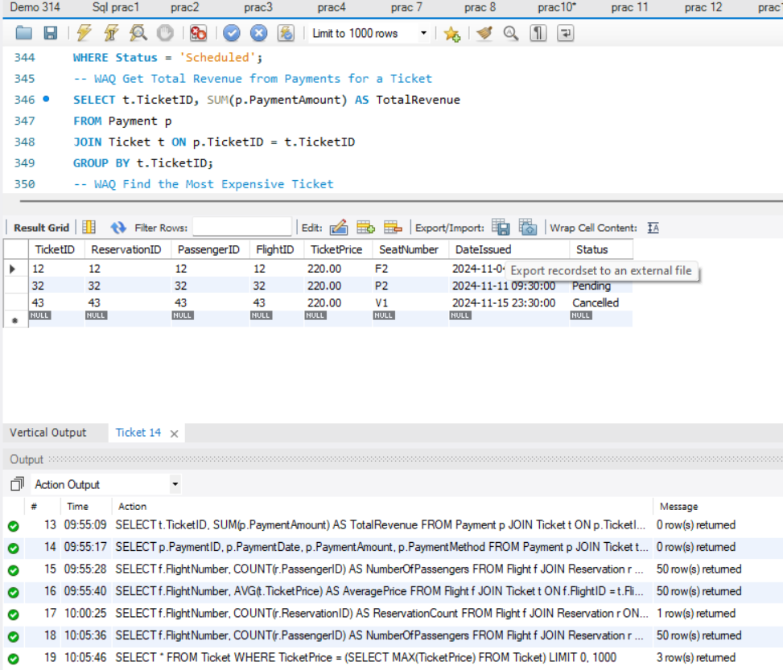
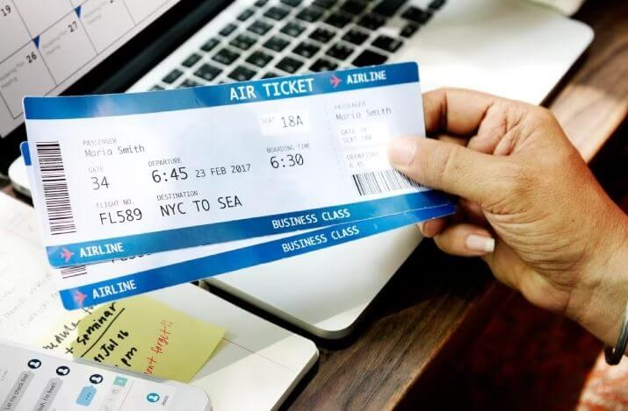
Find the Most Expensive Ticket?
SELECT * FROM Ticket WHERE TicketPrice = (SELECT MAX(TicketPrice) FROM Ticket);

Slide 17



Future Enhancements
Challenges:
Managing real-time updates for high traffic.
Ensuring security for sensitive passenger data.
Future Scope:
Integration with AI for dynamic pricing.
Real-time data replication for faster performance.
Enhanced analytics for customer insights.

Slide 18

Conclusion
SQL is the backbone of a reliable Airline Reservation System.
Enables efficient operations with structured data management.
Provides scalability and adaptability for future needs.

Slide 19


THANK YOU

